Slide 1
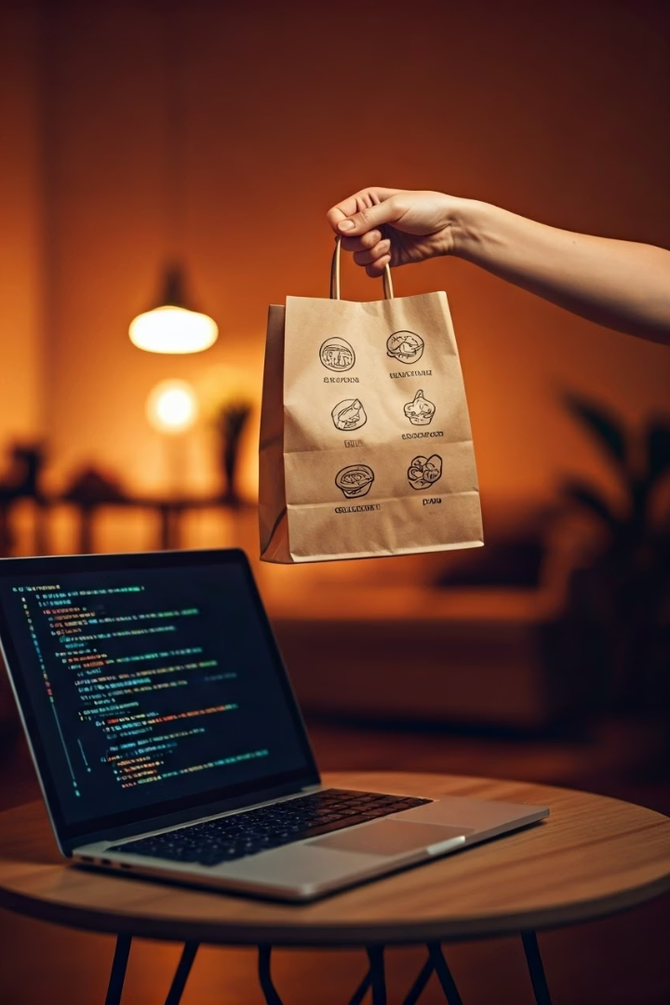
Food Delivery System
A C++ based console application designed for efficient food ordering.

Slide 2
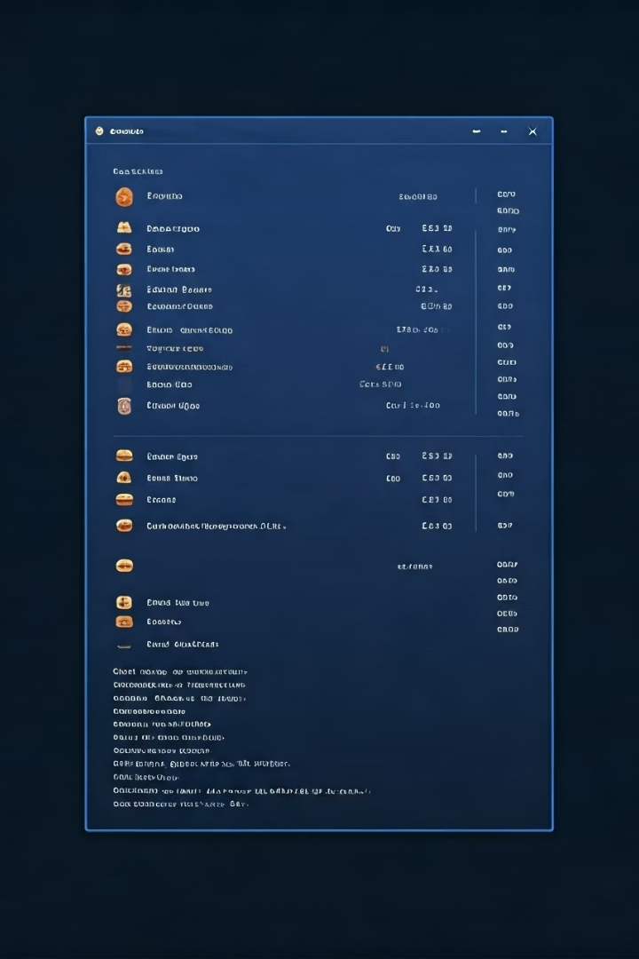



Project Overview
Console-based Application
Dual-user Interface
Handles both customer and owner interactions
Built using Object-Oriented Programming in C++
File Storage
Implements file handling for persistent data storage

Slide 3
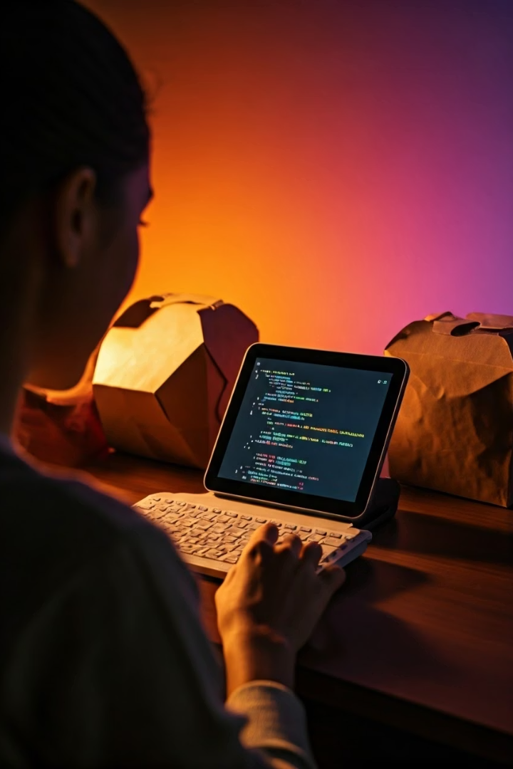
Main Features
User Management
Customer and owner registration with secure login functionality
Menu Operations
Comprehensive tools for owners to manage food items and pricing
Order System
Intuitive interface for placing and Watching food orders
Data Persistence
All system data stored in text files for retrieval across sessions

Slide 4








Class Structure
main()
System interface logic
User Classes
Customer and Owner inheritance
User_Authentification
Handles login & registration
Menu
Manage menu items

Slide 5

File Handling
Filename
Purpose
Operations
Menu.txt
Food items and prices
Read/Write/Append
User.txt
User credentials
Read/Write
Order.txt
Order history with timestamps
Append/Read

Slide 6
User Functionalities
Customer Features
Owner Features
Browse menu items
View complete menu
Place customized orders
Add new items
Add multiple items
Update existing items
View order history
Remove obsolete items

Slide 7
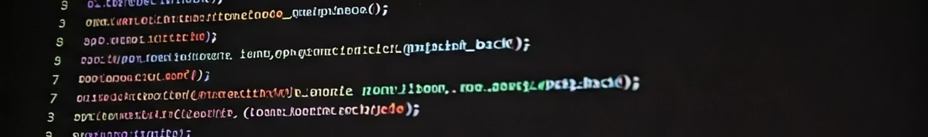




Code Implementation
Authentication
Email validation and role-based login system
Menu Management
Item existence verification before modifications
Order Processing
Size and flavor customization with multiple items
History Tracking
Timestamp-based order recording and retrieval

Slide 8






Future Enhancements
Real-time Tracking
Location-based order status updates
Payment Integration
Multiple payment methods with secure processing
Analytics Panel
Data-driven insights for business optimization

Slide 9
Thanks For Giving Us Time
Team Members:
M.Mustagees Shahid (24P-3052)
Mudassar Iqbal (24P-3083)

